Slide 1
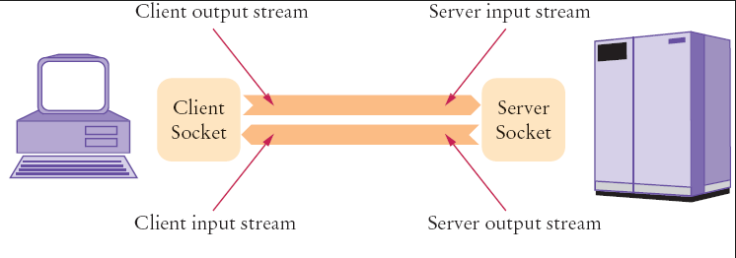
Java Socket Programming
Java Socket programming is used for communication between the applications running on different JRE.
Java Socket programming can be connection-oriented or connection-less.
Socket and ServerSocket classes are used for connection-oriented socket programming.
DatagramSocket and DatagramPacket classes are used for connection-less socket programming.
The client in socket programming must know two information:
IP Address of Server, and
Port number.

Slide 2
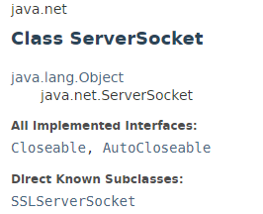
Java Socket Programming Example
This class implements server sockets. A server socket waits for requests to come in over the network. It performs some operation based on that request, and then possibly returns a result to the requester.

Slide 3
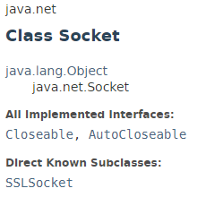
Java Socket Programming Example
This class implements client sockets (also called just "sockets"). A socket is an endpoint for communication between two machines.

Slide 4
Java Socket Programming Example
https://docs.oracle.com/javase/8/docs/api/index.html?java/net/ServerSocket.html
https://docs.oracle.com/javase/8/docs/api/index.html?java/net/Socket.html

